Slide 1
Creating a Flexible Organization

Slide 2
Learning Objectives
7-1 Understand what an organization is and identify its characteristics.
7-2 Explain why job specialization is important.
7-3 Identify the various bases for departmentalization.
7-4 Explain how decentralization follows from delegation.
7-5 Understand how the span of management describes an organization.

Slide 3
Learning Objectives (continued)
7-6 Describe the four basic forms of organizational structure.
7-7 Describe the effects of corporate culture.
7-8 Understand how committees and task forces are used.
7-9 Explain the functions of the informal organization and the grapevine in a business.

Slide 4
Why Do Companies Reorganize?
Lower operating costs
Providing high-quality products to ensure customer satisfaction
Focused consumer targeting
Specialized products
Other reasons?

Slide 5
What is an Organization?
An organization is a group of two or more people working together to achieve a common set of goals
An organization chart helps to illustrate the shape of an organization

Slide 6
Developing Organization Charts
An organization chart is a diagram that represents the positions and relationships within an organization
The chain of command is the line of authority that extends from the highest to the lowest levels of the organization

Slide 7
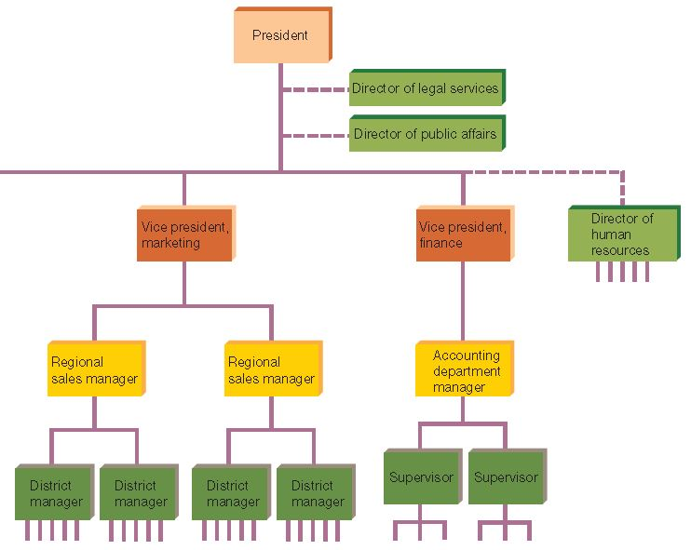
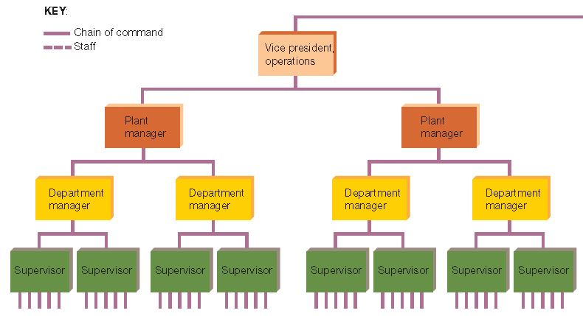
Chain of Command

Slide 8
To Chart or Not to Chart?
Consider:
What are examples of problems created by a missing, outdated, or otherwise inaccurate organization chart?

Slide 9
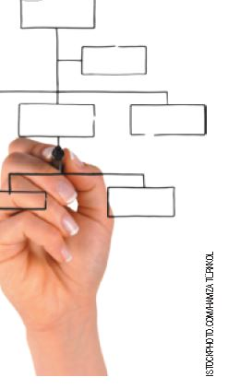
Major Considerations for
Organizing a Business
Organizing a firm focuses on:
  Job design
  Departmentalization
  Delegation
  Span of management
  Chain of command

Slide 10
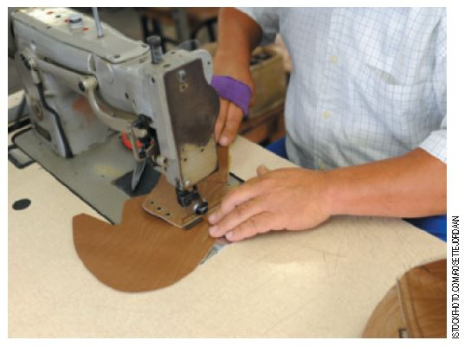
Job Design
Job specialization is the separation of all organizational activities into distinct tasks and the assignment of different tasks to different people

Slide 11
The Rationale for Specialization
Necessary in every organization because the “job” of most organizations is too large for one
A worker learning one specific, highly specialized task, can learn it quickly and perform it efficiently
A worker repeating the same job does not lose time changing operations
The more specialized the job:
  The easier it is to design specialized equipment
  The easier the job training

Slide 12
Job Specialization:
Risks and Alternatives
Risks:
Boredom
Higher absence rate
Low effort
Sabotage
Alternatives:
Job rotation
  Retain interest
  Learn new skills
  Identify new roles
Job enlargement
Job enrichment
Notes:
Article
The British Psychological Society
Boredom at Work
2/2007
http://www.thepsychologist.org.uk/archive/archive_home.cfm?volumeID=20&editionID=144&ArticleID=1144
Article
Quality Digest
Empowerment Makes the Team
http://www.qualitydigest.com/inside/quality-insider-article/empowerment-makes-team

Slide 13
Class Exercise
Consider:
What are the advantages of job specialization?
What are the disadvantages of job specialization?
What types of jobs lend themselves to specialization?
What types of jobs do not lend themselves to specialization?

Slide 14

Departmentalization
Departmentalization is the process of grouping jobs into manageable units
Most firms use one or more of the following:
  By function
  By product
  By location
  By customer
Notes:
Accenture is a consulting company that firms turn to for advice about reorganization of current structures and processes.
http://www.accenture.com

Slide 15
Departmentalization Bases
Basis | Type of Firm | Advantages | Disadvantages
Function | Smaller and newer | Simplified supervision and coordination | Slow decision-making Emphasizes department over company
Product | Older and larger | Easier decision-making Integration of related activities | Duplication of specialized activities Emphasizes product over company
Location | Decentralized with regional needs | Can respond to unique demands | Large administrative staff and control system
Customer | Service-based or market-specific | Can deal efficiently with unique customers | Larger-than-usual administrative staff

Slide 16
Departments by Job Function
CEO
Finance
Marketing
Operations
Type: Smaller and newer companies | Advantages: Simplified supervision and coordination | Disadvantages: Slow decision-making Emphasizes department over company

Slide 17
Departments by Product
CEO
Computers
Printers
Software
Type: Older and larger companies | Advantages: Easier decision-making Integration of related activities | Disadvantages: Duplication of specialized activities Emphasizes product over company

Slide 18
Department by Location
CEO
U.S. Region
European Region
Asian Region
Type: Decentralized companies with regional needs | Advantages: Can respond to unique demands | Disadvantages: Large administrative staff and control system

Slide 19
Department by Customer
CEO
Home Users
Business Users
Educational Users
Type: Service-based or market-specific needs | Advantages: Can deal efficiently with unique customers | Disadvantages: Large-than-usual administrative staff

Slide 20
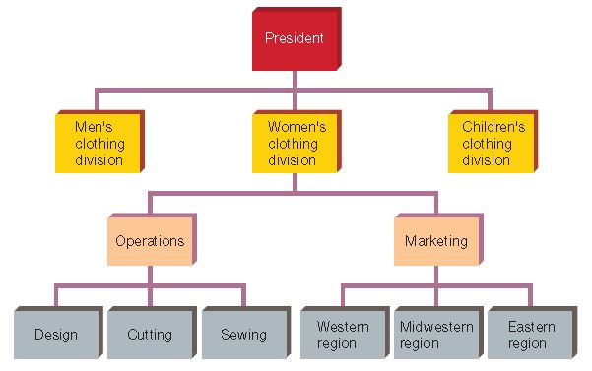
Multibase Departmentalization
Most firms use more than one basis for departmentalization to improve efficiency and to avoid overlapping positions

Slide 21
Delegation of Authority
Delegation is assigning part of a manager’s work and power to other workers
No manager can do everything
Develops the skills of subordinates
Leadership grooming

Slide 22
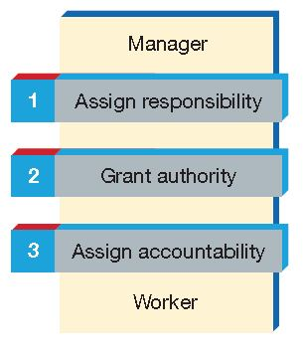
Delegation Process
Responsibility is the duty to do a job or perform a task
Authority is the power, within the organization, to accomplish an assigned job or task
Accountability is the obligation of a worker to accomplish an assigned job or task

Slide 23
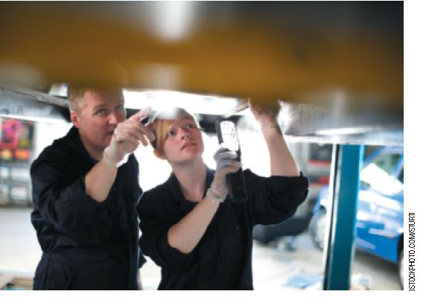
Barriers to Delegation
Fear the work will not get done
Fear the work will be done too well
Disorganization
Notes:
Video
Delgation
2:27
http://www.youtube.com/watch?v=6wSNacZljQ8

Slide 24

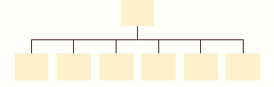
Decentralization of Authority
Centralized Organization
Authority is systematically concentrated at
highest levels
Decentralized Organization
Authority is consciously spread widely across levels

Slide 25
Decentralization of Authority: Factors
Factors | Organizational Tendency
Business environment is complicated or unpredictable | Decentralize
Risky decision | Centralize
Lower-level managers don't have strong decision making skills | Centralize
Traditional practice | Maintain
Consider:
What are some examples of businesses that lend themselves to centralized or decentralized organization?
Notes:
Centralized vs. Decentralized articles and resources
Houston Chronicle
Decentralized Company Business Structure
http://smallbusiness.chron.com/decentralized-company-business-structure-20629.html
Historical Perspective
The Quality of Managers in Centralized versus Decentralized Organizations
Raaj K. Sah and Joseph E. Stiglitz
February 1991
http://academiccommons.columbia.edu/download/fedora_content/download/ac:148212/CONTENT/Sah_Stiglitz.pdf

Slide 26
The Span of Management
Span of management (or span of control) is the number of workers who report directly to one manager
Wide span
  Large number of
  subordinates to one manager
Narrow span
  Only a few subordinates
  to one manager
Organizational height
  The number of layers, or levels, of management in a firm
Notes:
Article
Chicago Tribune
BP to restructure oil, gas operations, sources say
11/23/12
http://articles.chicagotribune.com/2012-11-23/business/chi-bp-to-restructure-oil-gas-operations-sources-say-20121123_1_chief-executive-bob-dudley-bp-insider-tony-hayward

Slide 27
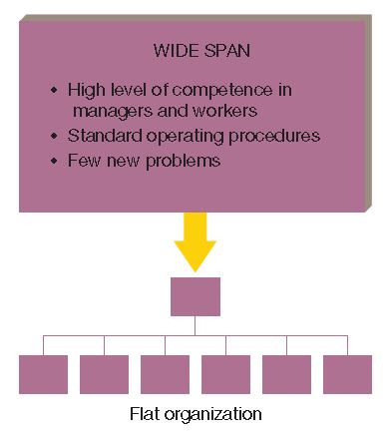
The Span of Management: Wide Span
Flat organizations require managers to perform more administrative tasks and spend more time supervising subordinates

Slide 28
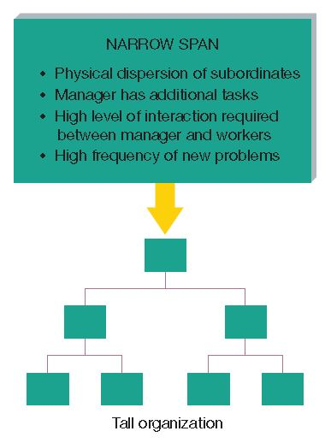
The Span of Management: Narrow Span
Tall organizations have higher administrative costs
Internal communications may become distorted

Slide 29
Forms of Organizational Structure
Line Structure
Line-and-Staff Structure
Matrix Structure
Network Structure

Slide 30
The Line Structure
Simplest and oldest form
Direct chain of command
throughout organization
Line managers make
decisions and give orders
to workers
  Quick decisions with direct accountability
  Line managers must have a wide range of knowledge
  Popular in small organizations

Slide 31
The Line-and-Staff Structure
Staff managers provide
line managers with support
and expertise
Staff managers have
advisory authority
Line managers have
functional authority
To minimize conflict between staff and line managers:
  Integrate line and staff managers into one team
  Clearly define areas of responsibility
  Hold managers separately accountable

Slide 32
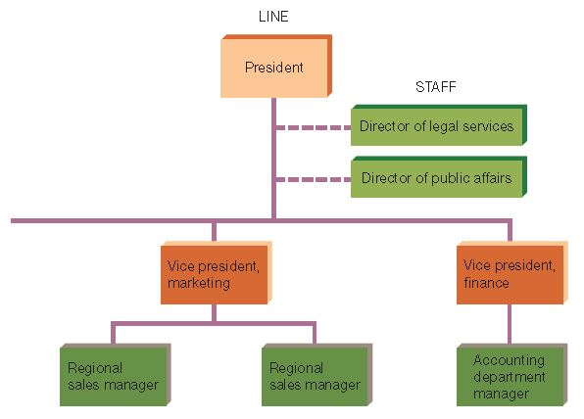
Line and Staff Managers
A line manager has direct responsibility for achieving the company’s goals and is in the direct chain of command
A staff manager supports and advises the line managers

Slide 33
The Matrix Structure
Combines horizontal and vertical lines of authority
Cross-functional teams work on projects led by a
project manager
Team members report to a project manager and
functional manager

Slide 34
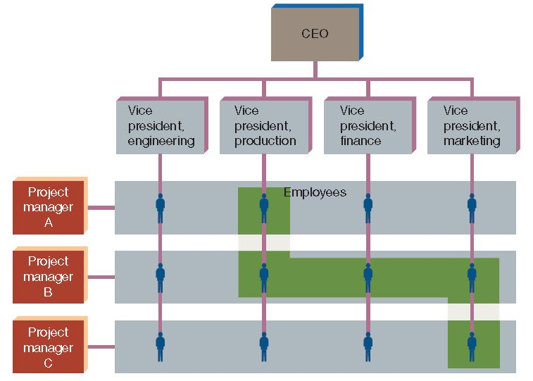
The Matrix Structure (continued)
A matrix is usually the result of combining product departmentalization with function departmentalization
It is a complex structure in which employees have more than one supervisor
Source: Ricky W. Griffin, Fundamentals of Management, 8th ed. Copyright © 2016, p. 180 by South-Western/Cengage Learning, Mason, OH. Adapted with permission.

Slide 35
The Matrix Structure:
Advantages and Disadvantages
  Advantages
  Added flexibility
  Increased productivity
  Higher morale
  Increases in creativity and innovation
  Personal development
  of team members
Disadvantages
Chain of command conflicts
May take longer to resolve problems and reach solutions
Personality clashes
Poor communications
Undefined individual roles
Unclear responsibilities
Difficulty in determining how to reward individual and team performance
Notes:
Article
Challenges and Strategies of Matrix Organizations: Top-Level and Mid-Level Managers' Perspectives
By Thomas Sy, College of Business Administration, California State University, Long Beach; Laura Sue D'Annunzio, A.T. Kearney Inc
Human Resource Planning
2005
http://thematrixco.com/download/i/mark_dl/u/4006983785/4527114385/AT Kearny Matrix Article.pdf

Slide 36
The Network Structure
Administration is the primary function
A few permanent employees consisting of top management and clerical workers
Other functions performed by vendors and contractors
Sometimes called a virtual organization

Slide 37
The Network Structure (continued)
Leased facilities and equipment, as well as temporary workers, are increased as needed
Flexibility allows quick adjustments
More likely to survive if an important leader or member leaves
Challenges include quality control, dissatisfaction of hourly workers, and vulnerability of relying on outside vendors and contractors

Slide 38
Corporate Culture
A corporate culture is the inner rites, rituals, heroes, and values of a firm
A corporate culture:
  Has a powerful influence on how employees think and act
  Determines public perception
  Has a strong influence on performance over time

Slide 39

Corporate Culture Indicators
Physical setting (e.g., building and office layout)
Corporate statements about itself (advertising and press releases)
How the company treats
its guests
How employees spend
their time

Slide 40
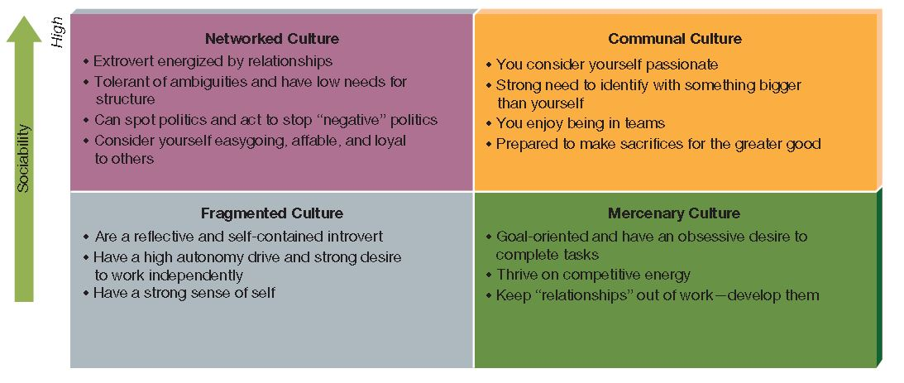
Types of Corporate Culture
Source: “Types of Corporate Culture,” in Rob Goffee and Gareth Jones, The Character of a Corporation (New York: HarperCollins, 1998). Copyright © 1998 by Rob Goffee and Gareth Jones. Permission granted by Rob Goffee and Gareth Jones.
Which corporate culture would you choose?
Notes:
Video
Zappos Corporate Culture Presentation
9:17
9/8/10
http://www.youtube.com/watch?v=pyIFsDyn6m8
Video
TEDx
Igniting creativity to transform corporate culture: Catherine Courage at TEDxKyoto 2012
13:49
10/17/12
http://www.youtube.com/watch?v=01Y7qlPFpqw

Slide 41
Corporate Culture: When to Change
Cultural change is needed when:
A company’s environment changes
The industry becomes more competitive
Company performance is mediocre
The company is growing or becomes a large firm
Examples:
  Goldman Sachs
  General Mills
  Alcoa
  Aetna
Notes:
Column
Financial Times
Corporate Culture: Lofty Aspirations
http://www.ft.com/intl/cms/s/0/d1b4b71a-ccde-11e1-9960-00144feabdc0.html#axzz2DIzYoFRs
Op-Ed
NYTimes
Why I Am Leaving Goldman Sachs
http://www.nytimes.com/2012/03/14/opinion/why-i-am-leaving-goldman-sachs.html?ref=business&gwh=42FF9474C1512ADE525A02D4B450E8D8&_r=0

Slide 42
Role of Corporate Culture
Increase growth, profit, productivity, and job satisfaction
Retain the best people
Inspire customer loyalty
Develop new markets
Increase creativity
Smooth mergers and acquisitions

Slide 43
Committees and Task Forces
An ad hoc committee is created for a specific short-term purpose
  Example: Reviewing employee benefits plan
  Disbands when work is finished
A standing committee is a relatively permanent committee charged with performing a recurring task
  Example: Budget review committee
A task force is a committee established to investigate a major problem or pending decision
  Example: Assessing pros and cons of a merger

Slide 44
Committees:
Advantages and Disadvantages
  Advantages
  Members bring different knowledge and skills to task
  Tend to make accurate decisions
  Transmit results through the organization more effectively
Disadvantages
Deliberations take longer
Unnecessary compromise may take place
One person may dominate

Slide 45

The Informal Organization and the Grapevine
The informal organization is the pattern of behavior and interaction that stems from personal rather than official relationships
Informal groups
  Formed by the members
  themselves to accomplish
  goals that may or may
  not be relevant to the
  organization
  Can be powerful forces in
  organizations exerting
  positive as well as negative influences

Slide 46
The Informal Organization and the Grapevine
The grapevine is the informal communications network within an organization
  Completely separate from the organization’s formal communication channels
  Sometimes faster
  May be accurate or distorted
  Managers should respond promptly and aggressively to correct misinformation
  Consider:
  How should managers treat the grapevine?
© NEVENA RADONJA/SHUTTERSTOCK

